Slide 1
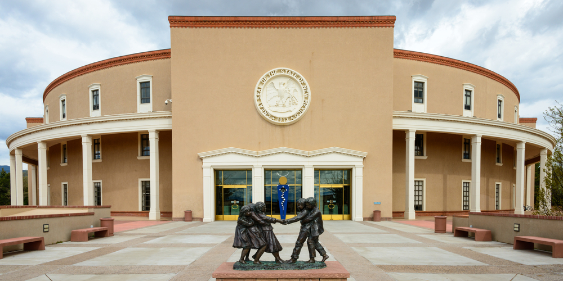

New Mexico
Citizen Redistricting Committee
Española, NM
August 15, 2021

Slide 2
Principles of Redistricting
Equal population
Minority Voting Rights
Contiguity
Compactness
Communities of interest
2

Slide 3
2020 New Mexico Population
2020 Census | 2,117,522
Change (2010 to 2020) | 58,343
% Change | 2.8%

Slide 4
New Mexico Population Change
1990-2000 | 20.1%
2000-2010 | 13.2%
2010-2020 | 2.8%
4

Slide 5
New Mexico Population 1910-2020
5

Slide 6
NM Counties Population Change
2000 to 2010 and 2010 to 2020
Counties that have experienced population increase
County (Largest City) | 2010 Population | 2020 Population | Population Change 2010-2020 | % Population Change 2000 - 2010 | % Population Change 2010 - 2020
Eddy County (Carlsbad) | 53,829 | 62,314 | 8,485 | 4.2% | 15.8%
Lea County (Hobbs) | 64,727 | 74,455 | 9,728 | 16.6% | 15.0%
Sandoval County (Rio Rancho) | 131,561 | 148,834 | 17,273 | 46.3% | 13.1%
Los Alamos County (Los Alamos) | 17,950 | 19,419 | 1,469 | -2.1% | 8.2%
Santa Fe County (Santa Fe) | 144,170 | 154,823 | 10,653 | 11.5% | 7.4%
Otero County (Alamogordo) | 63,797 | 67,839 | 4,042 | 2.4% | 6.3%
Doña Ana County (Las Cruces) | 209,233 | 219,561 | 10,328 | 19.8% | 4.9%
Taos County (Taos) | 32,937 | 34,489 | 1,552 | 9.9% | 4.7%
Bernalillo County (Albuquerque) | 662,564 | 676,444 | 13,880 | 19.0% | 2.1%
McKinley County (Gallup) | 71,492 | 72,902 | 1,410 | -4.4% | 2.0%
6

Slide 7
NM Counties Population Change
2000 to 2010 and 2010 to 2020 (cont.)
Counties that have experienced population decline
County (Largest City) | 2010 Population | 2020 Population | Population Change 2010-2020 | % Population Change 2000 - 2010 | % Population Change 2010 - 2020
Cibola County (Grants) | 27,213 | 27,172 | -41 | 6.3% | -0.2%
Valencia County (Los Lunas) | 76,569 | 76,205 | -364 | 15.7% | -0.5%
Chaves County (Roswell) | 65,645 | 65,157 | -488 | 6.9% | -0.7%
Lincoln County (Ruidoso) | 20,497 | 20,269 | -228 | 5.6% | -1.1%
Quay County (Tucumcari) | 9,041 | 8,746 | -295 | -11.0% | -3.3%
Roosevelt County (Portales) | 19,846 | 19,191 | -655 | 10.1% | -3.3%
Sierra County (T or C) | 11,988 | 11,576 | -412 | -9.7% | -3.4%
Catron County (Reserve) | 3,725 | 3,579 | -146 | 5.1% | -3.9%
Grant County (Silver City) | 29,514 | 28,185 | -1,329 | -4.8% | -4.5%
Guadalupe County (Santa Rosa) | 4,687 | 4,452 | -235 | 0.1% | -5.0%
Harding County (Roy) | 695 | 657 | -38 | -14.2% | -5.5%
San Juan County (Farmington) | 130,044 | 121,661 | -8,383 | 14.3% | -6.4%
Socorro County (Socorro) | 17,866 | 16,595 | -1,271 | -1.2% | -7.1%
San Miguel County (Las Vegas) | 29,393 | 27,201 | -2,192 | -2.4% | -7.5%
Torrance County (Moriarty) | 16,383 | 15,045 | -1,338 | -3.1% | -8.2%
Colfax County (Raton) | 13,750 | 12,387 | -1,363 | -3.1% | -9.9%
Union County (Clayton) | 4,549 | 4,079 | -470 | 9.0% | -10.3%
Mora County (Wagon Mound) | 4,881 | 4,189 | -692 | -5.8% | -14.2%
Hidalgo County (Lordsburg) | 4,894 | 4,178 | -716 | -17.5% | -14.6%
De Baca County (Fort Sumner) | 2,022 | 1,698 | -324 | -9.7% | -16.0%
New Mexico | 2,059,179 | 2,117,522 | 58,343 | 13.2% | 2.8%
7

Slide 8
Regional Counties Population Change
2000 to 2010 and 2010 to 2020
County (Largest City) | 2010 Population | 2020 Population | Population Change 2010-2020 | % Population Change 2000 - 2010 | % Population Change 2010 - 2020
Rio Arriba County (Española) | 40,246 | 40,363 | 117 | -2.3% | 0.3%
Santa Fe County (Santa Fe) | 144,170 | 154,823 | 10,653 | 11.5% | 7.4%
Los Alamos County (Los Alamos) | 17,950 | 19,419 | 1,469 | -2.1% | 8.2%
Mora County (Wagon Mound) | 4,881 | 4,189 | -692 | -5.8% | -14.2%
San Miguel County (Las Vegas) | 29,393 | 27,201 | -2,192 | -2.4% | -7.5%
Taos County (Taos) | 32,937 | 34,489 | 1,552 | 9.9% | 4.7%
Colfax County (Raton) | 13,750 | 12,387 | -1,363 | -3.1% | -9.9%
 | 283,327 | 292,871 | 9,544 | 5.6% | 3.4%
8

Slide 9
Ideal District Population
Ideal District Population =
total state population/# of districts
Governmental Entity | # of Districts | Ideal Population
NM Congressional Districts | 3 | 705,841
State Senate Districts | 42 | 50,417
State House Districts | 70 | 30,250
Public Education Commission | 10 | 211,752
2020 New Mexico Population: 2,117,522
9

Slide 10
Congressional District Deviations
District | Population | Deviation | % Deviation
Congressional District 1 | 694,577 | -11,264 | -1.60%
Congressional District 2 | 714,022 | 8,181 | 1.16%
Congressional District 3 | 708,923 | 3,082 | 0.44%
Ideal Population | 705,841

Slide 11
Allowable Deviation from
the Ideal Population
NM Congressional Districts
As equal as “practicable”
Goal: zero deviation
(unless that deviation is justified by legitimate state objectives)
NM State House and Senate Districts
Must be “Substantially Equal”
No more than 10% total population deviation between
smallest and largest district
11

Slide 12
Minority Voting Strength
Dilution of Minority Voting Strength
Do not dilute voting strength of ethnic/language minority groups (Voting Rights Act, Section 2):
  Native Americans
  African Americans
  Hispanics
Give the minority population an opportunity to elect a candidate of their choice
Three criteria that need to be met to require single-member districts under federal case law (Thornburg v. Gingles, 478 U.S. 30 [1986])
  Minority population is compact and large enough to constitute a majority in a single-member district
  Minority population is politically cohesive
  Bloc voting by White population

Slide 13
Minority Voting Strength (cont.)
Dilution of Minority Voting Strength (cont.)
Must meet all three criteria and establish, by a totality of the circumstances, that political processes are not equally open to minorities in that minority group members have less opportunities to participate and elect representatives of their choosing. Historical data is often used to establish this.
Racial Gerrymander
Do not create districts in which race is the predominant criterion in subordination of traditional districting principles (Shaw v. Reno, 509 U.S. 630 (1993))
North Carolina – 12th CD
1991
13

Slide 14
Minority Voting Strength (cont.)
Racial Gerrymander (cont.)
Packing
Concentrate as much of a minority group into as few districts as possible to minimize the number of districts in which the minority could elect a candidate of their choice
Avoid Packing
Cracking
Split up a minority into as many districts as possible to minimize influence in any given district
Avoid Cracking
14

Slide 15
Compactness
Different ways to measure compactness
  None are perfect
Refers to shape, not geographic size
  Could have a very large district in area that is compact in shape
Compact
Not Compact
NM – 3rd CD
1991
TX – 18th CD
1991
15

Slide 16
Traditional Districting Principles
(CRC Rules)
CRC Districts Shall be:
Reasonably compact
Contiguous, single member districts
Attempt to preserve communities of interest
Take into consideration:
Geographic and political boundaries
Including political subdivisions, and Indian nations, tribes, and pueblos
Be composed of entire precincts and may split them only if necessary to comply with Voting Rights Act.
CRC Districts May:
Preserve the core of existing districts (subordinate to the above).

Slide 17
Traditional Districting Principles
(CRC Rules) cont.
CRC Districts Shall Not:
Use partisan election data or voter registration data in designing plans, except to ensure that a plan complies with federal law (i.e. Voting Rights Act).
Consider the voting address of incumbents except to avoid pairing them, unless other districting principles do not necessitate the pairing.

Slide 18
New Mexico Racial/Ethnic Profile
Change from 2010 to 2020 Census
 | 2010 | 2020
Non-Hispanic White | 40.5% | 36.5%
Hispanic | 46.3% | 47.7%
Native American (non-Hispanic) | 8.5% | 8.9%
African-American (non-Hispanic) | 1.7% | 1.8%
Asian (non-Hispanic) | 1.3% | 1.7%
Other (non-Hispanic) | 1.8% | 3.4%
18
Source: U.S. Census Bureau, 2010 and 2020 Census

Slide 19
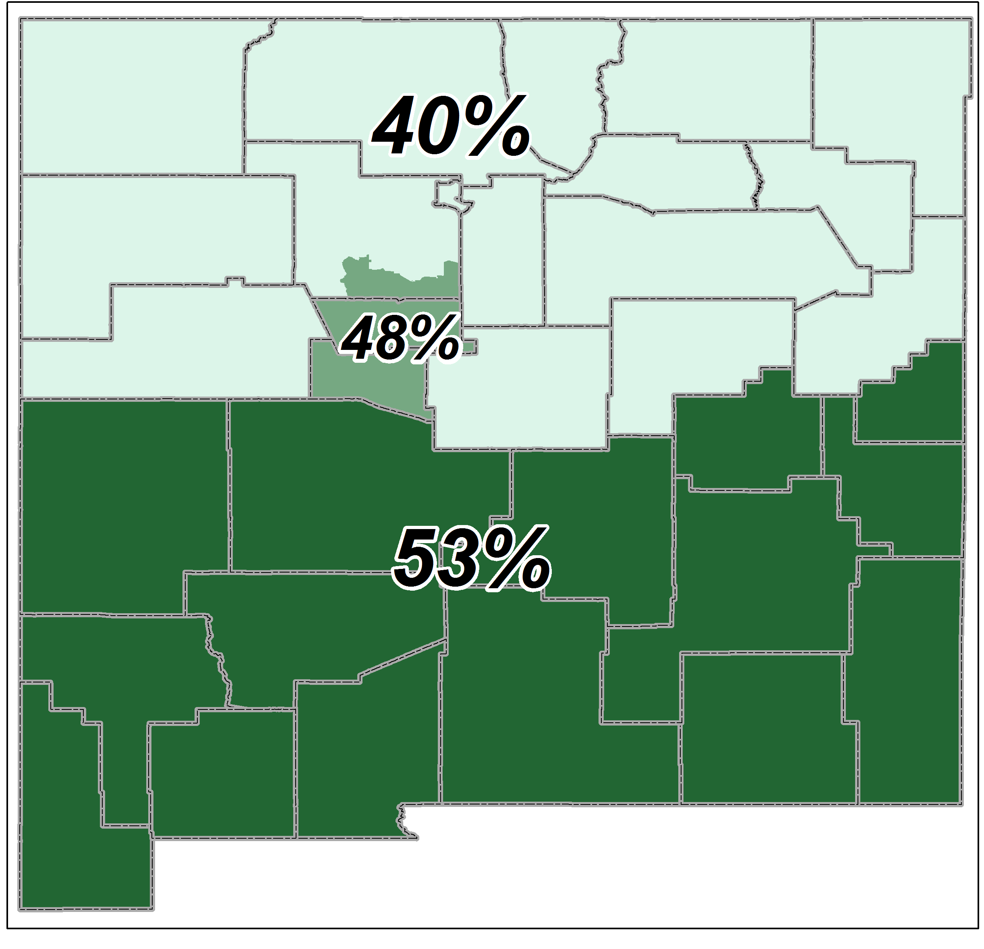
New Mexico Regions -
% Hispanic
19

Slide 20
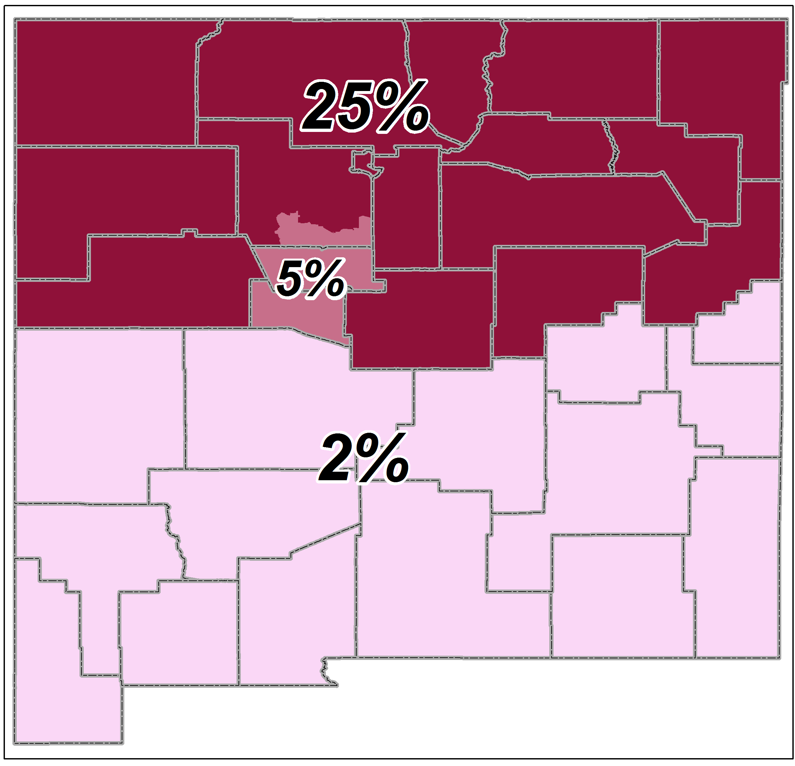
New Mexico Regions -
% Native American
20

