Slide 1
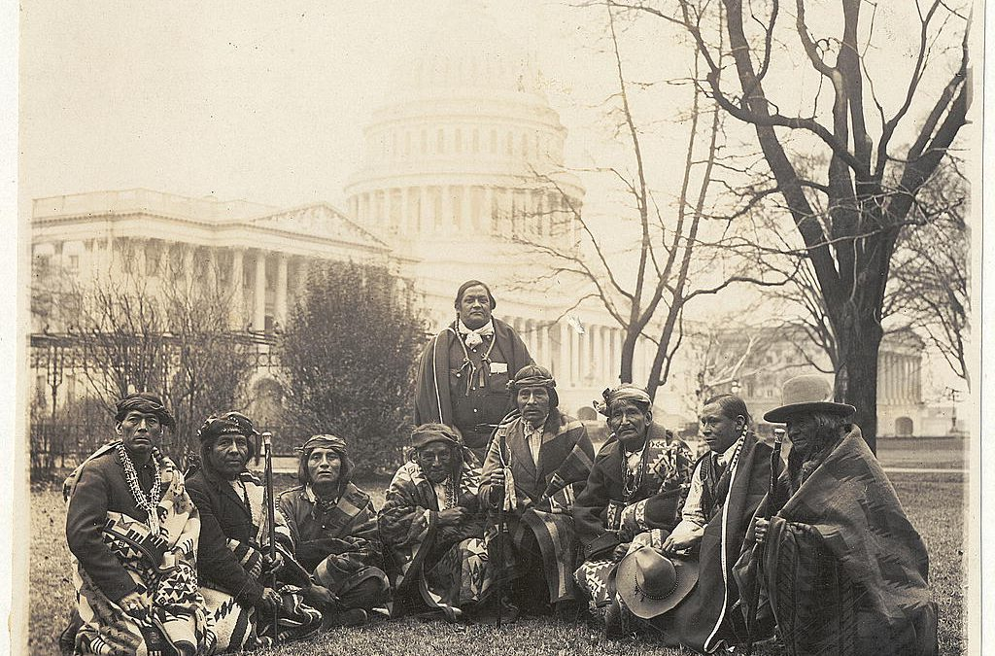
The History of Redistricting,
Voting Rights, and the Sovereign Nations
of New Mexico
Presented by: Casey Douma
(Laguna Pueblo/Hopi-Tewa)
Co-Chair, All Pueblo Council of Governors Redistricting Committee

Slide 2
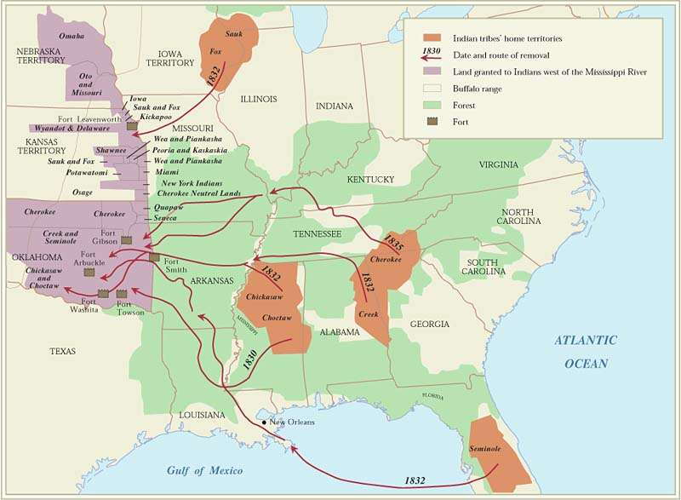
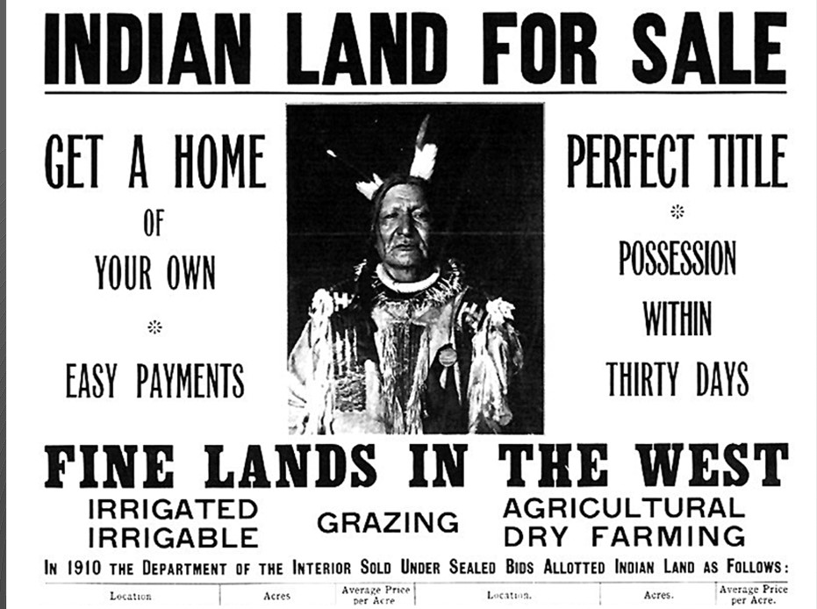
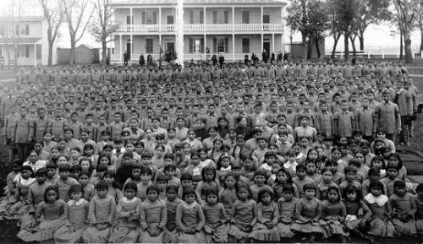
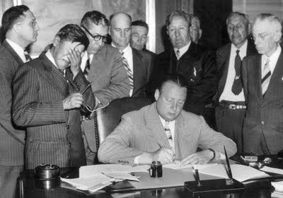
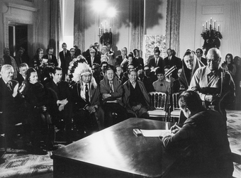
Historic Eras of Federal Indian Policy
Indian Removal Era 1828-1887
Allotment/Reservation Era 1887-1934
Assimilation Era 1887-1934
Indian Reorganization 1934-1945
Termination Era 1945-1968
Self-Determination Era 1968-2000

Slide 3
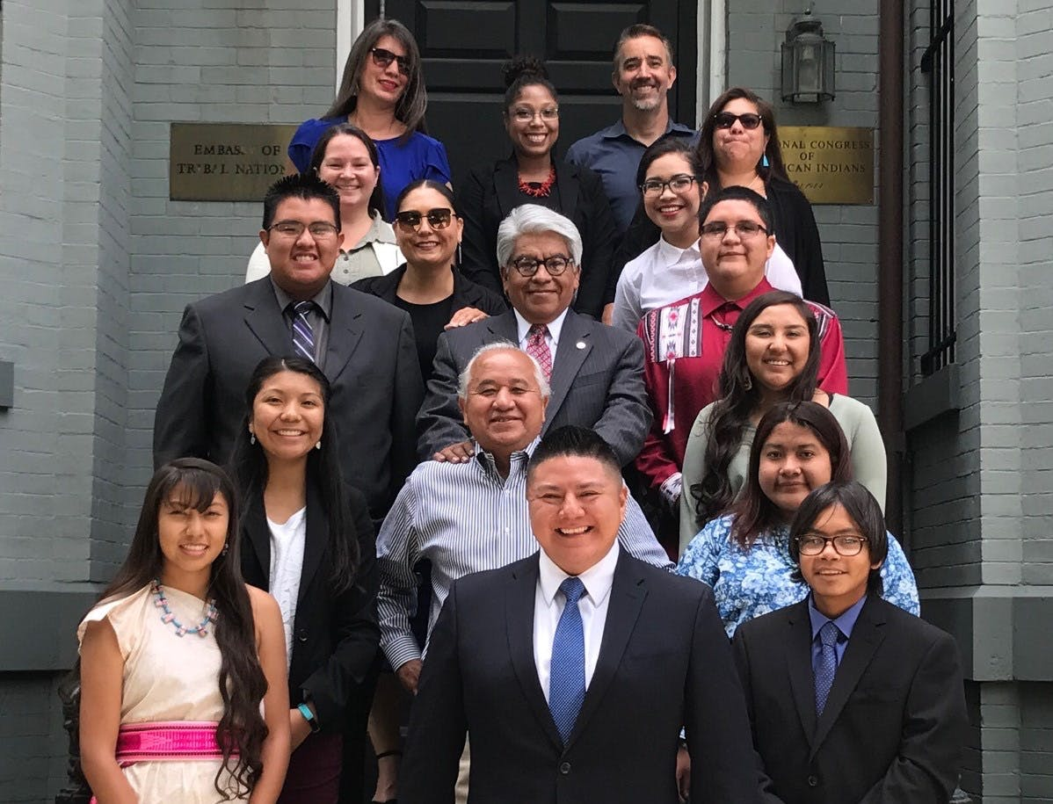
Sovereign Nations
Tribal Nations are sovereign governments, with citizens, designated boundaries, governed by laws, tied to unique cultures and languages.
Tribal Nation’s inherent authority is not given to tribes by the United States. A tribes authority to govern predates the United States Constitution.
  Talton v. Mayes, 163 U.S. 376 (1898).
Political Distinction vs. Racial Preference
  Morton v. Mancari, 417 US 535 (1974).
Notes:
Tribes authority for economic development
Taxation

Slide 4
Self-Determination, Consultation, and Consent
State of New Mexico
  State -Tribal Collaboration Act (2009)
U.S. Executive Orders
  Executive Order 13175 (2000): Consultation and Coordination with Indian Tribal Governments
  Presidential Memorandum Nov. 5, 2009.
    Directing each agency to submit a detailed plan of action to implement Executive Order 13175.
  DOT Order 5301.1 (Nov. 1999): Directs DOT to build more effective working relationships with tribal governments.
Federal Law
  National Historic Preservation Act Section 106: Requires consultation with Indian tribes whenever an agency’s undertakings may impact historic places associated with the a tribe.
  National Environmental Policy Act (NEPA).
  Native American Graves Protection & Repatriation Act (NAGPRA).
  American Indian Religious Freedom Act of 1978.
United Nations Declaration on the Rights of Indigenous Peoples (2007)
  Free, Prior, and Informed Consent
  Aspirational goals of the United States.

Slide 5
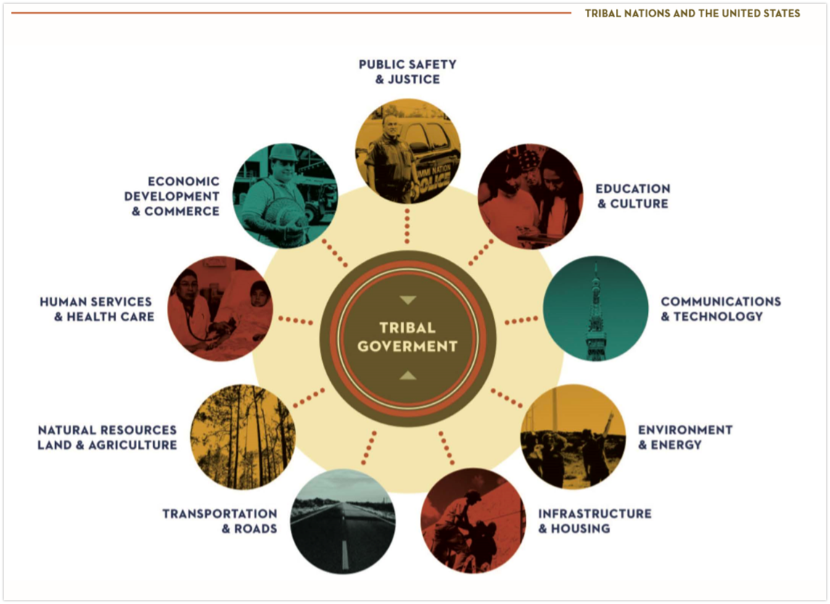
Tribal Nations Today
* National Congress of American Indians

Slide 6
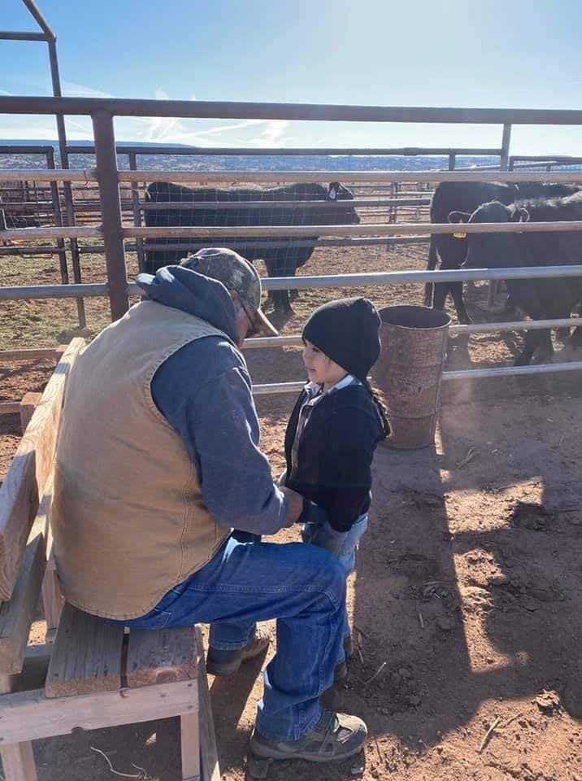
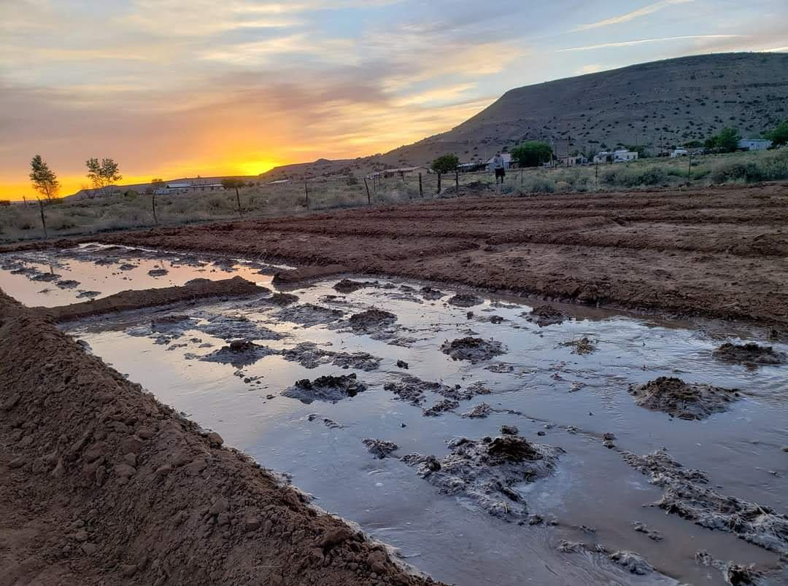
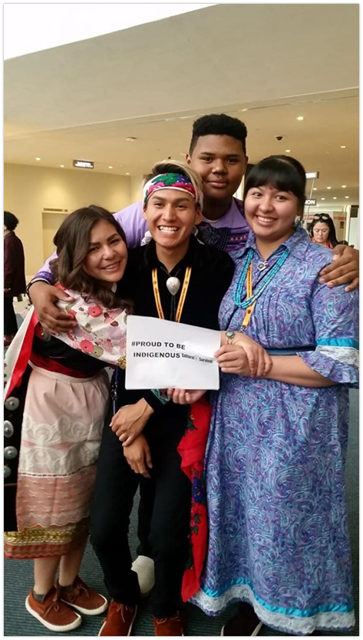
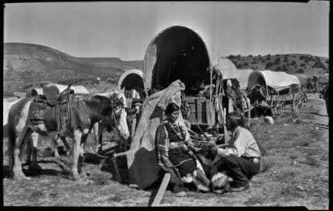
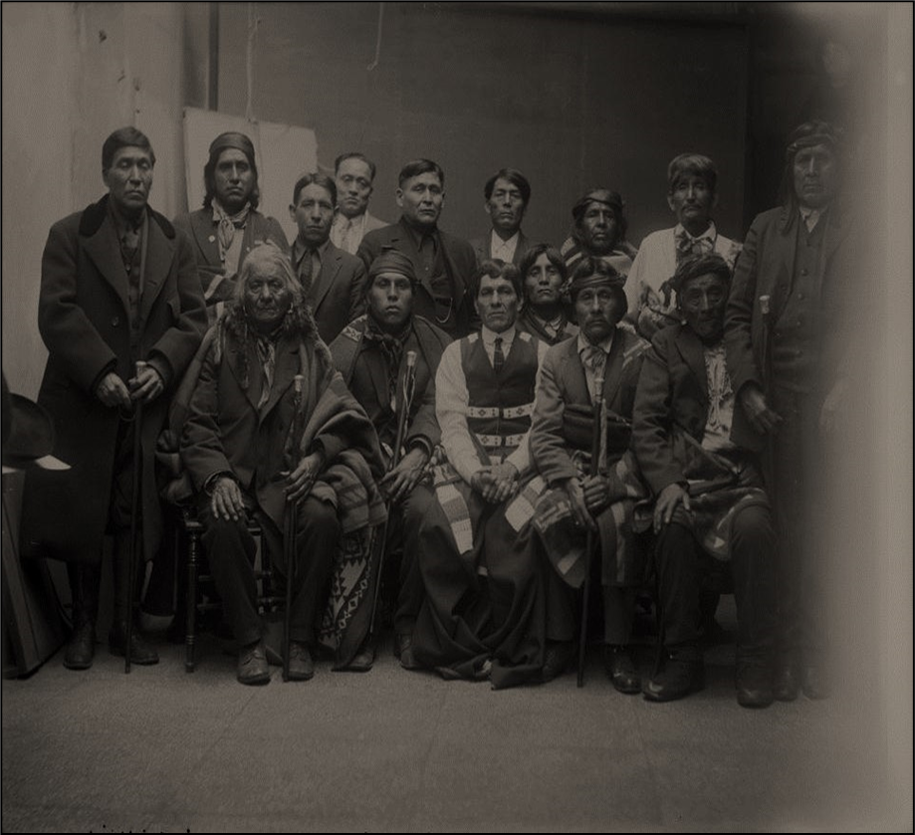
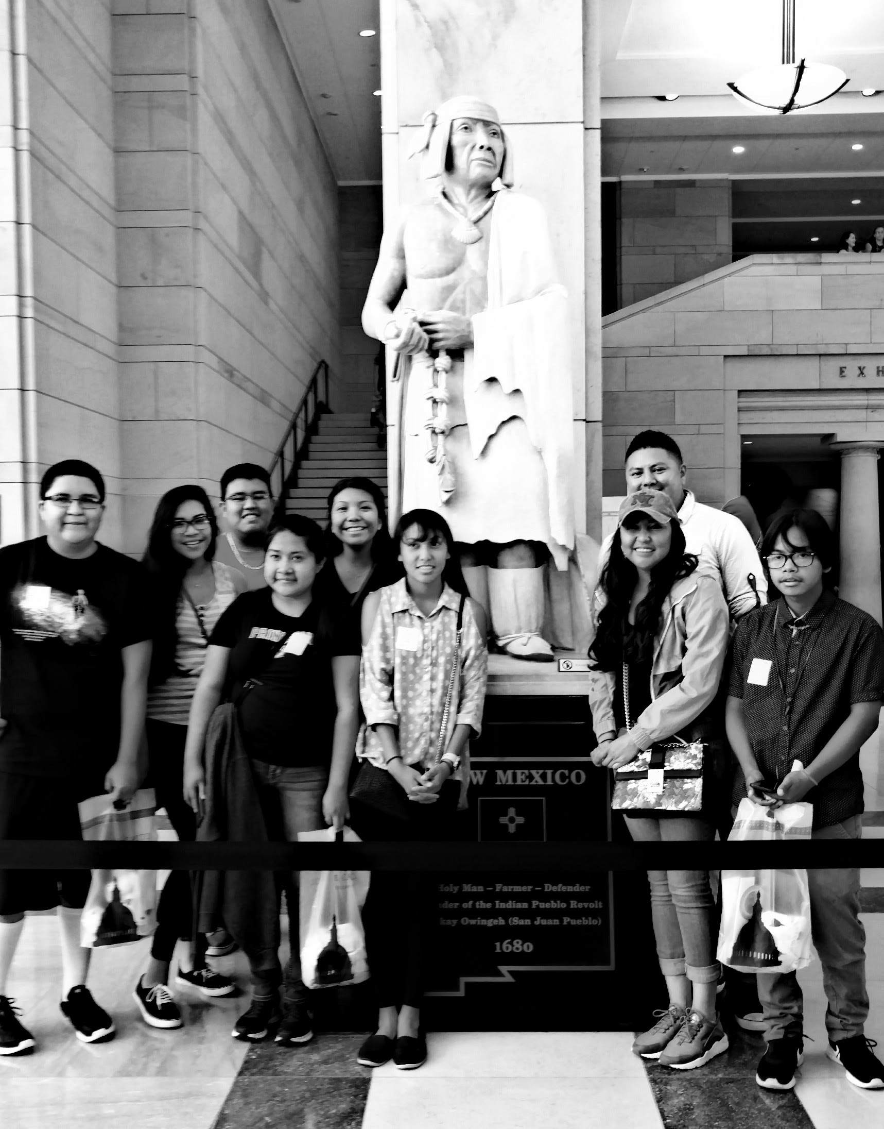
Communities of Interests

Slide 7
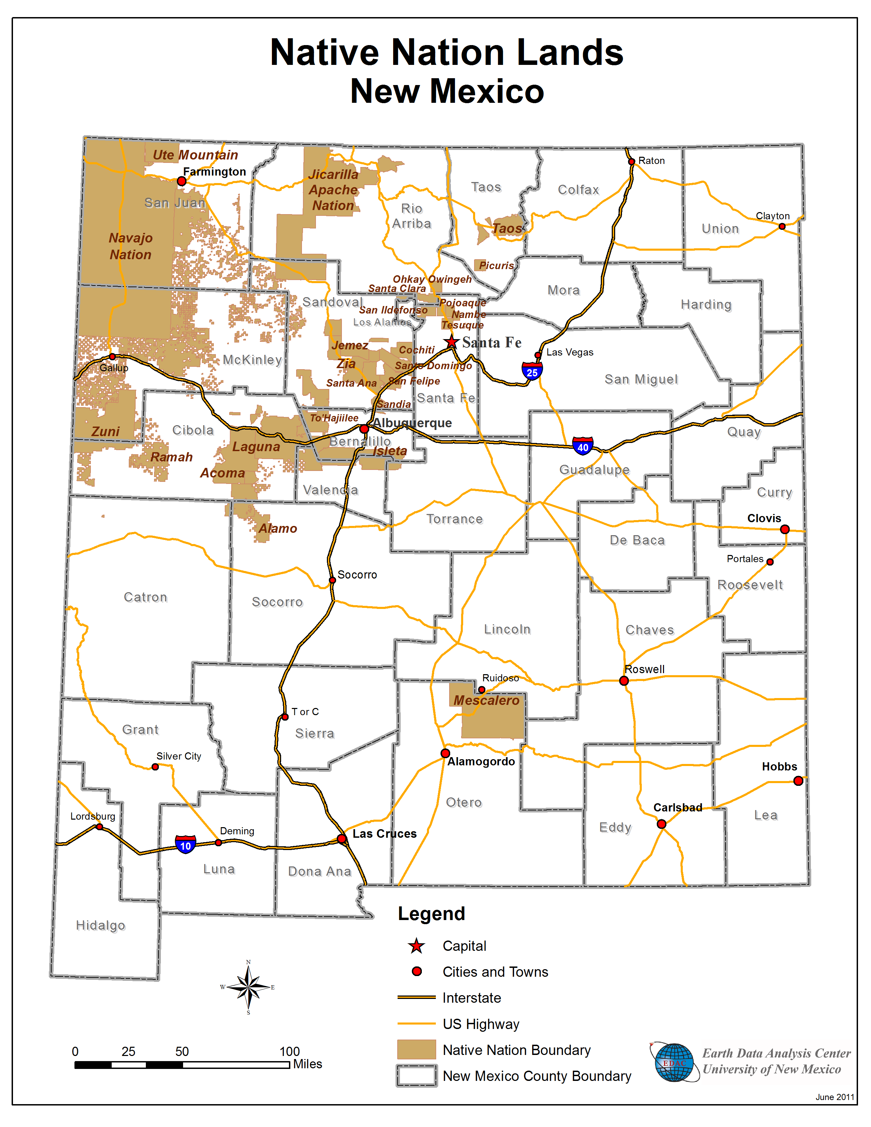
New Mexico Pueblos, Nations, Tribes
      Pueblos
Acoma San Felipe
Cochiti San Ildefonso
Isleta Santa Ana
Jemez Santa Clara
Laguna Kewa
Nambe Taos
Ohkay Owingeh Tesuque
Picuris Zuni
Pojoaque Zia
Sandia
Navajo Nation
Jicarilla Apache Nation
Mescalero Apache Tribe
Fort Sill Apache Tribe

Slide 8
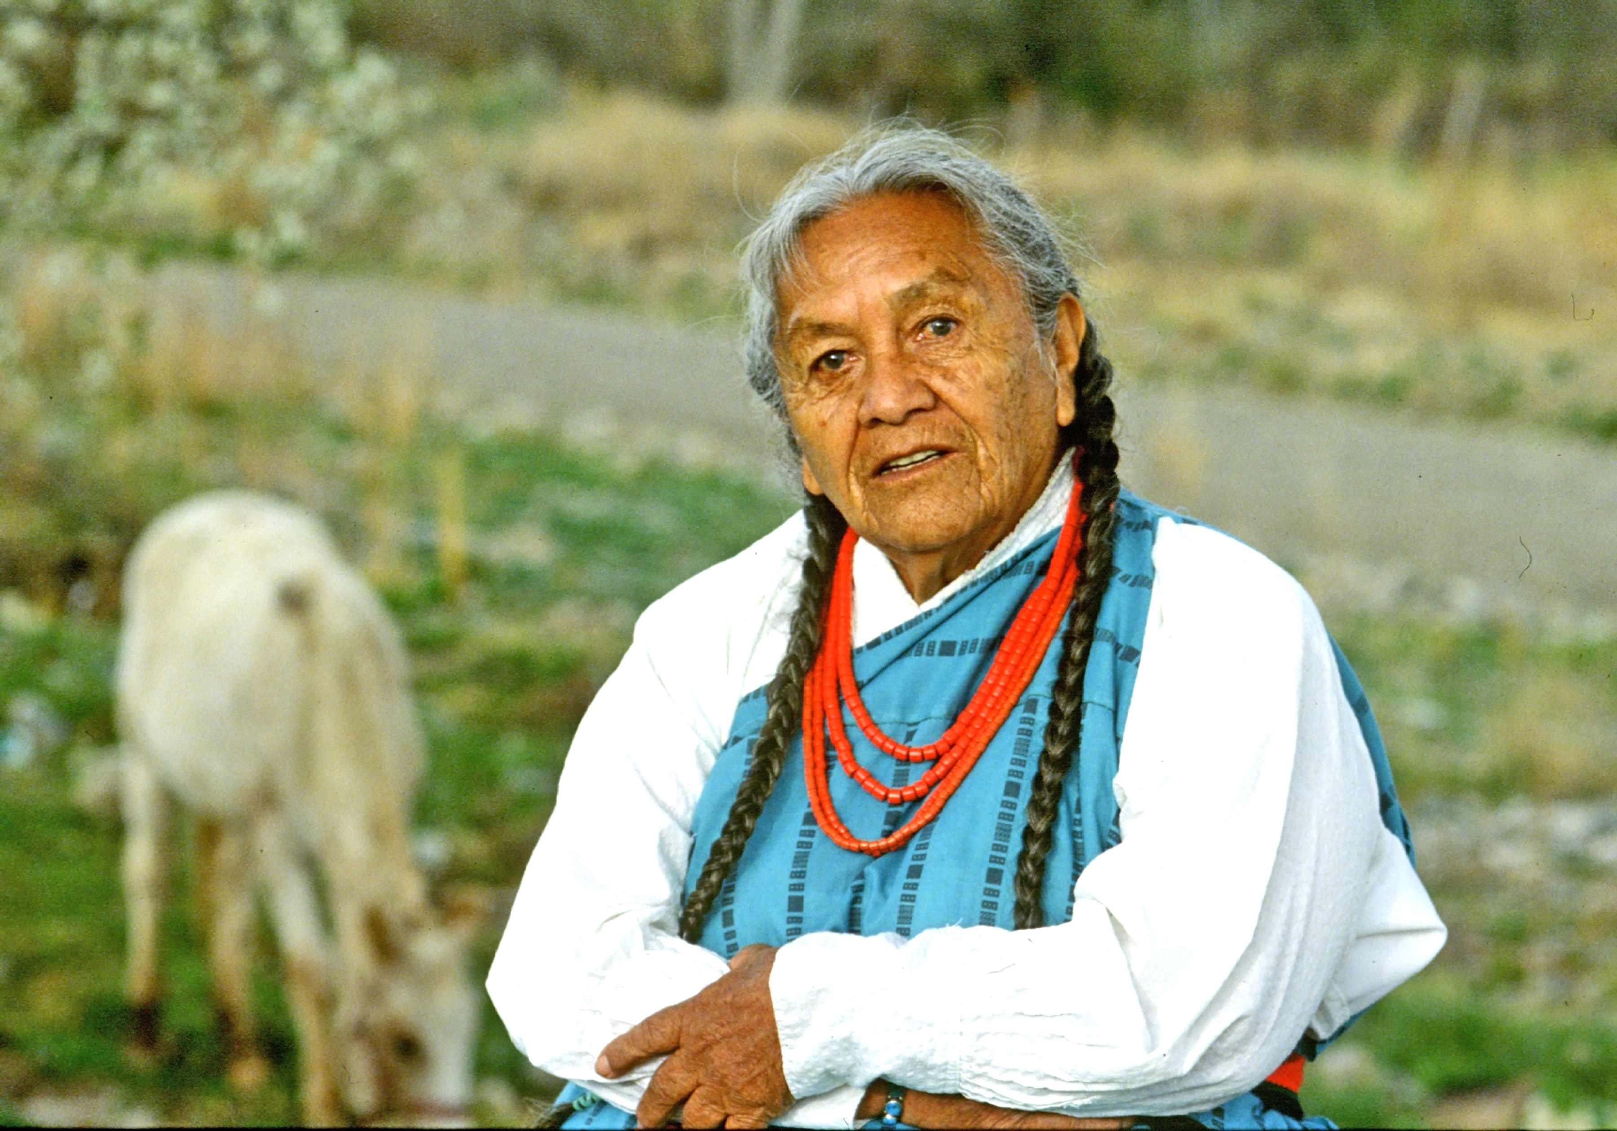
Pueblo Languages
Keres
  Acoma Pueblo San Felipe Pueblo
  Laguna Pueblo Kewa Pueblo
  Zia Pueblo Cochiti Pueblo
  Santa Ana Pueblo
Tewa
  Nambe Pueblo Santa Clara Pueblo
  Ohkay Owingeh San Ildefonso Pueblo
  Pojoaque Pueblo Tesuque Pueblo
Tiwa
  Picuris Pueblo Taos Pueblo
  Isleta Pueblo Sandia Pueblo
Towa
  Jemez Pueblo
Zuni
  Zuni Pueblo

Slide 9
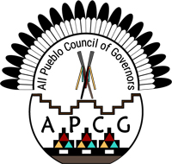
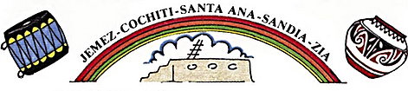
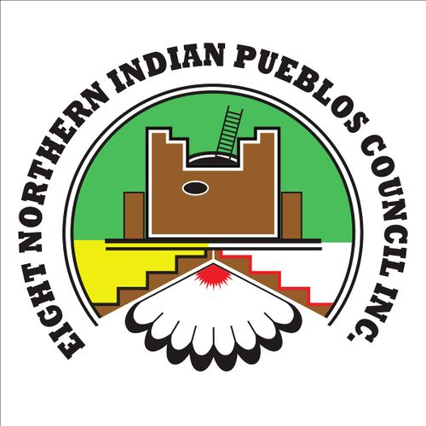
Pueblo Alliances
All Pueblo Council of Governors
To advocate, foster, protect and encourage the social, cultural, and traditional well-being of our Pueblo Nations. Through our inherent and sovereign rights, we will promote language, health, economic and educational advancement of all Pueblo people.
Five Sandoval Indian Pueblos, Inc.
Five Sandoval Indian Pueblos, Inc. was founded in 1967 and incorporated in 1973 to address the social needs of its Pueblo tribes in Sandoval County by providing professional services to assist and enhance their lives. Five Sandoval is one of the oldest Native American non-profit organizations in New Mexico. Throughout its history, the Governing Board of Pueblo Tribal Governors has been an essential component to the existence and success of Five Sandoval.
Eight Northern Indian Pueblos Council, Inc.
ENIPC, Inc. was incorporated as a New Mexico nonprofit organization in 1962. Since that time, the tribal Governors have met on a monthly basis to discuss common issues, which directly affect their century-old communities. For over nearly 40 years, ENIPC, Inc. has served men, women and children in these Pueblos and other constituents, by offering a broad variety of economic, educational and social service programs.

Slide 10
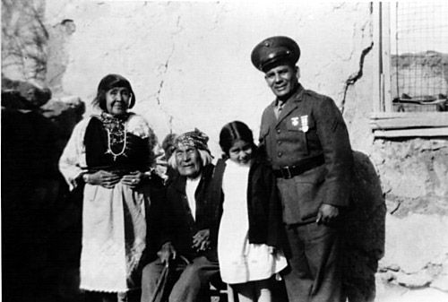
Native American Voting Rights
Miguel Trujillo (Isleta Pueblo)
In 1948, sued the State of New Mexico for the right to vote

Slide 11
Electoral Discrimination Against Native Americans
New Mexico denied Native Americans the right to vote until 1948 (Pueblo) and 1962 (Navajo).
  Trujillo v. Garley (1948)
  Montoya v. Bolack (1962)
As a result of past discrimination, many Native Americans in New Mexico grew up in households where voting was not an established practice.

Slide 12
Consent Decree
Cibola County and Sandoval County
  Under Consent Decree starting in 1994 for violations of the Voting Rights Act related to Native Americans.
  Sandoval Country Consent Decree extended to 2013.
  Cibola County Consent Decree extended to 2012.

Slide 13
New Mexico Redistricting
2001 New Mexico Redistricting
  Jicarilla Apache & Navajo Nation
2011 New Mexico Redistricting
  APCG, Pueblo Nations, Navajo Nation, Jicarilla Apache Nation
  Consensus Building
  Legislative Session
  Litigation
    Multi-Tribal Plaintiffs

Slide 14
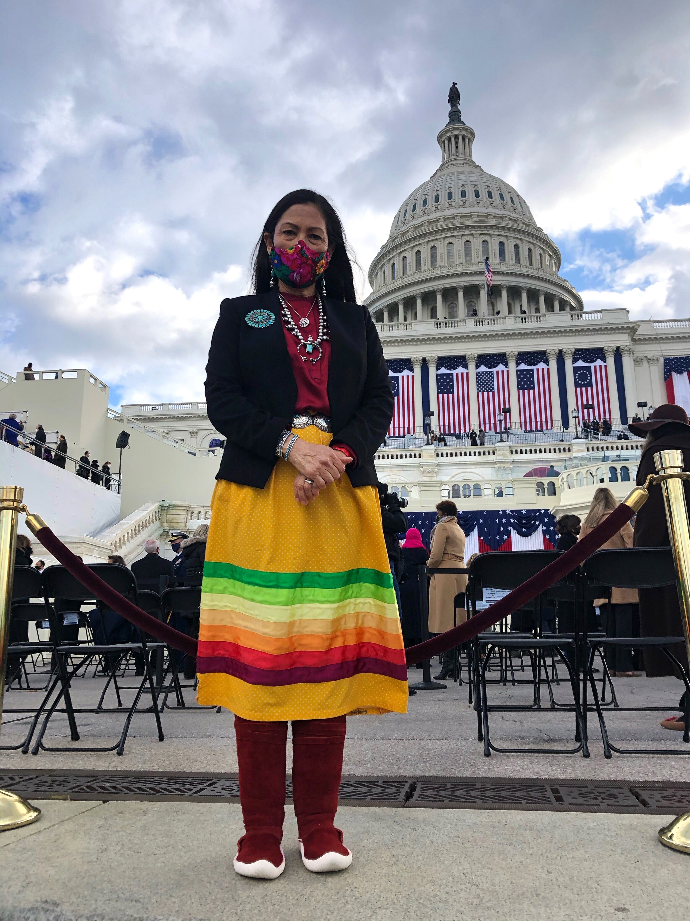
Making History: Impacts of Redistricting
Secretary Debra Haaland
Laguna Pueblo/Jemez Pueblo
One of the 1st Native Women elected to Congress
First Native American to head the Dept. of the Interior

